Slide 1
Agenda
File Formats -- Details
Data Transformation - Json
Data Loading – Json
Data Loading – Performance & Best Practices

Slide 2
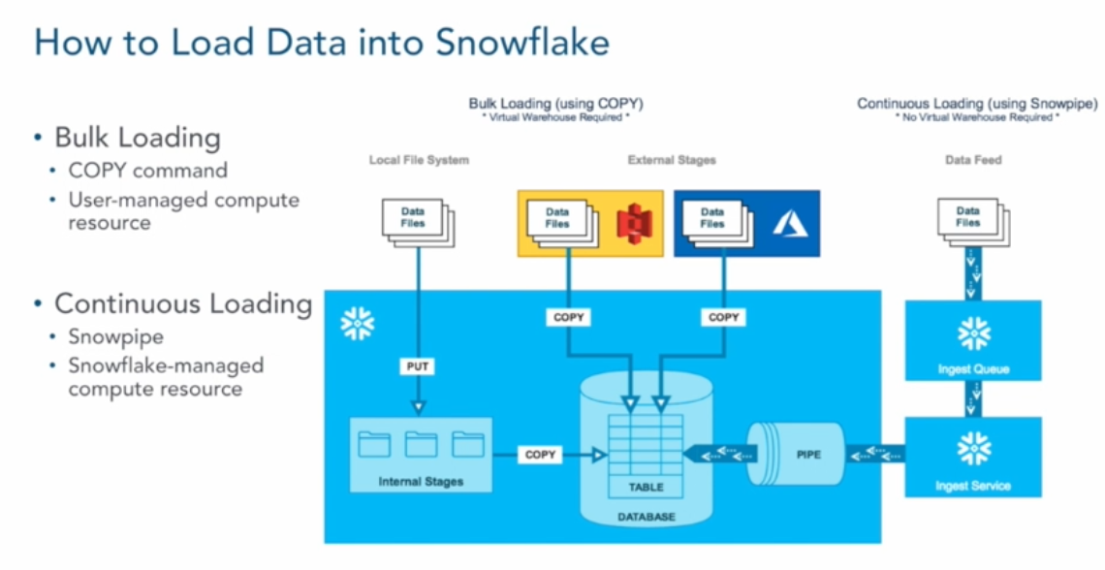
Data Loading - Bulk Copy
Data Loading Into Snowflake

Slide 3
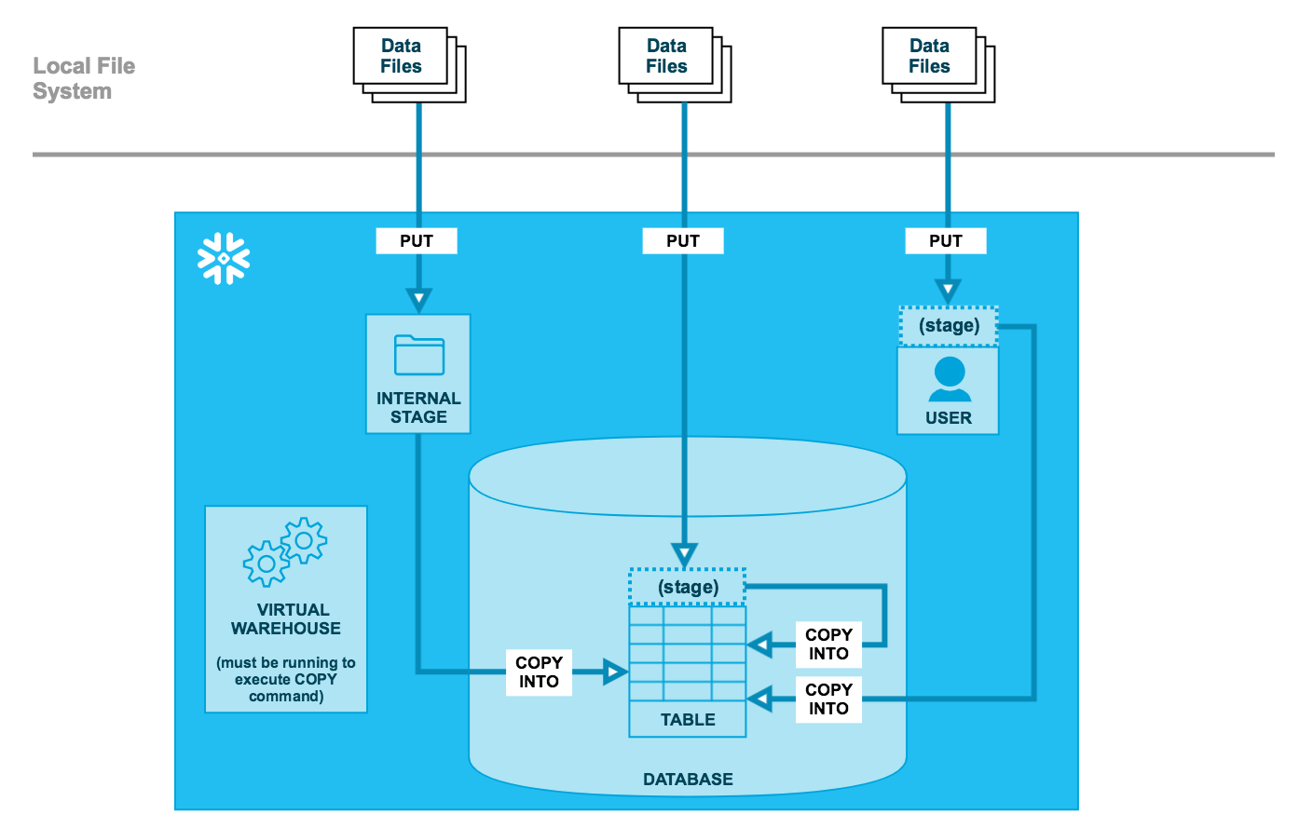
Data Loading - Bulk Copy

Slide 4
Data Loading
Snowflake
Data Loading
Snowflake Data Loading
Limited Data
Bulk Data
Continuous Data
Limited Data
Done usually using Web UI
Small Sets of Data Loading using GUI Interface
Bulk Data
Done Usually Using Snowsql
Using ETL Tools
Large Files, Parallel Processing
Continuous Data
Loading Continuous Stream Data into Snowflake – Using Snowpipe

Slide 5


Snowflake Stages
Stages
Table Stage
Named Stage
Permanent
Temporary
User Stage
External stage

Slide 6
Snowflake Stages
Table Stage
Each table has a Snowflake stage allocated to it by default for storing files
This stage is a convenient option if your files need to be accessible to multiple users and only need to be copied into a single table(#)
User Stage
Each User has a stage allocated by default for storing Files
All the worksheets are stored in this stage
Will be accessed by single user
Will be useful if the same file needs to be copied to multiple tables
No Setting of File Format Options(~)
Internal Named Stage
Internal stages are named database objects that provide the greatest degree of flexibility for data loading
Users with the appropriate privileges on the stage can load data into any table.
Explicitly grant privileges on the stage to one or more roles before users with those roles can use the stage.
Internal Temporary Stage – Stays for 24 Hours(@)
External Stage
Stage to connect to AWS S3, Azure Blob, GCP Storage

Slide 7
Viewing Stages
User Stage
List @~;
Table Stage
List @%mytable
Internal Named Stage
List @my_stage_name
External Stage
List @external_Stage

Slide 8

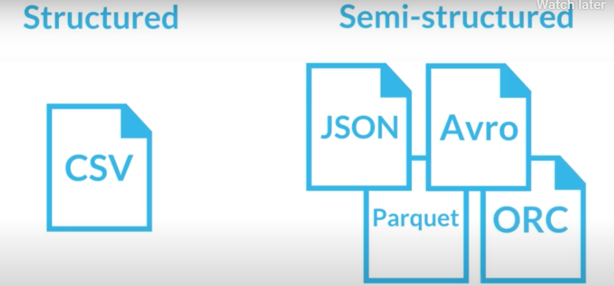
Data Loading Data & File Formats

Slide 9
Data Loading Web UI
Login to Snowflake Account
Click on Databases Menu
Click on Table for which you have to load the data
You Will See Load Data Menu on the top of Table Column Names
Select Your Warehouse and Click On Next
Select your file for Loading
Select File Format, If not created Create a file Format (Choose your file Format, Name It and Create it) and Click on Next
Select your Load Options and Load the File

Slide 10
Data Loading Bulk Copy Snowsql
Create File Format
Create Stage Object
Stage the Data Files
Bulk Copy Data into Tables
Verify Data
Purge Stage Data

Slide 11
Data Loading Data & File Formats

Slide 12
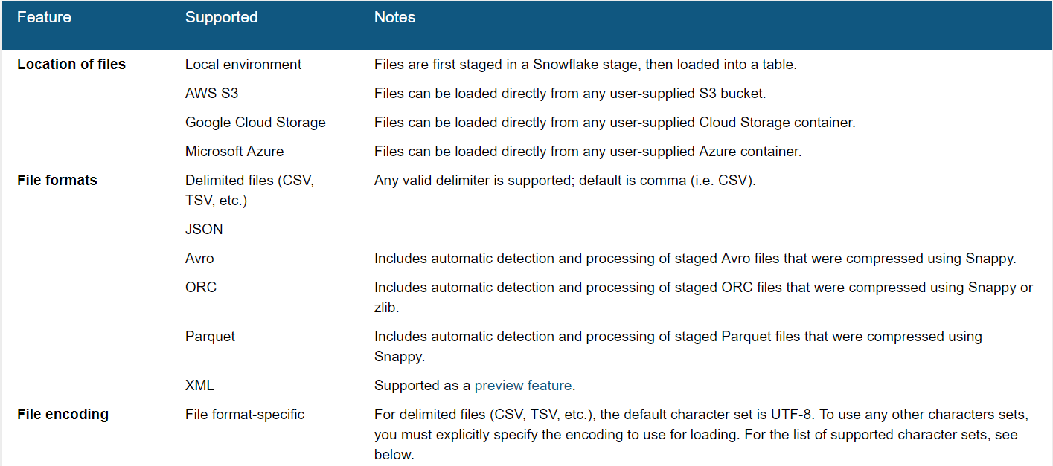
Data Loading – File Format
Data File Details

Slide 13
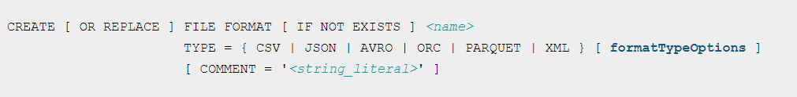
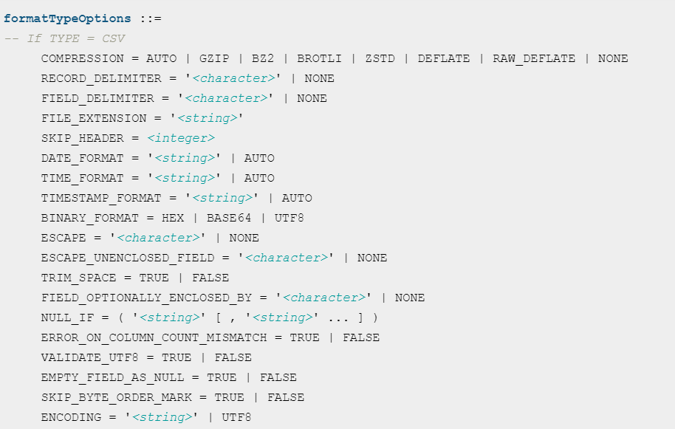
File Formats

Slide 14
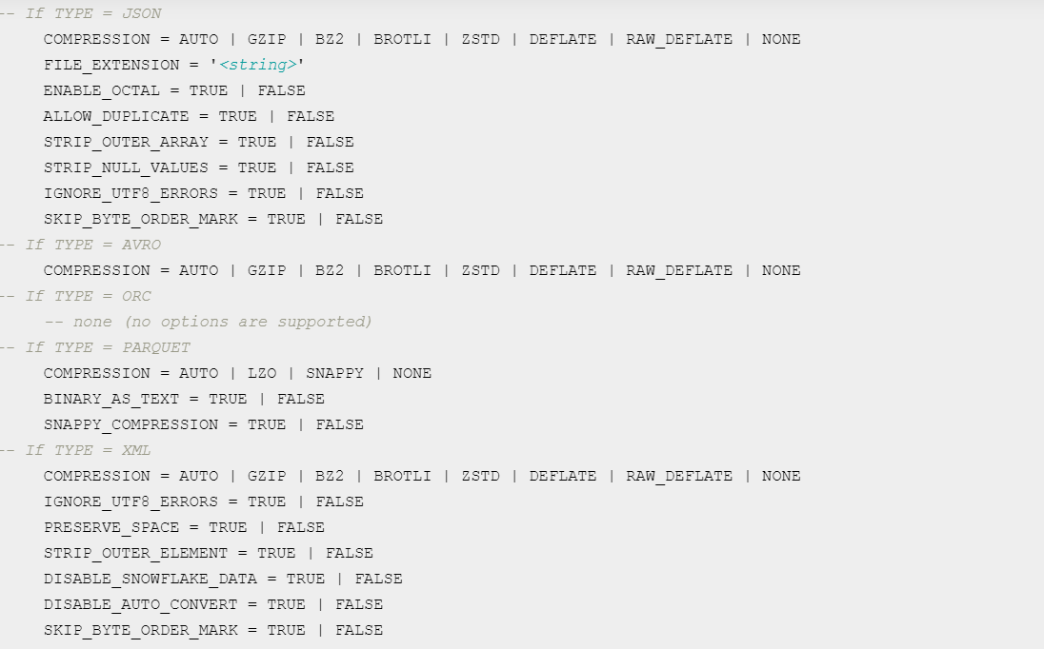
File Formats..

Slide 15
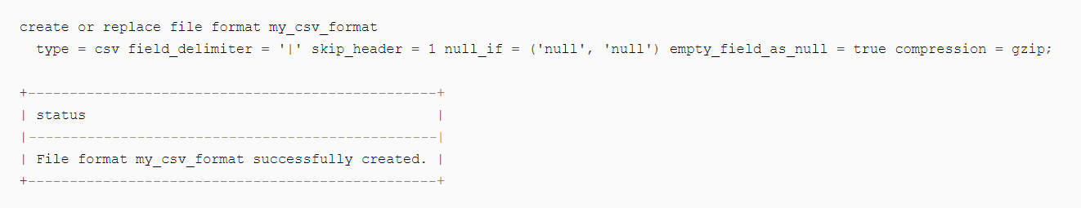

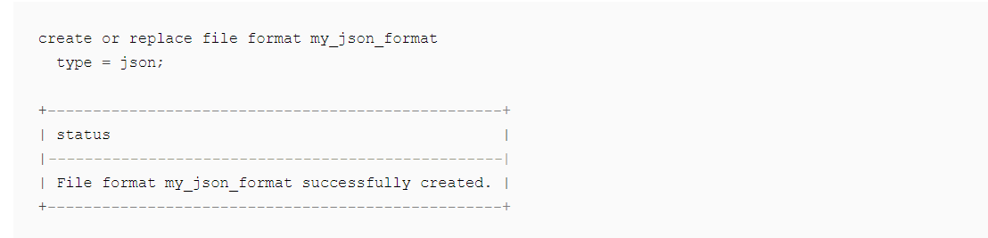
File Format
create or replace file format sf_tut_parquet_format type = 'parquet’;
create or replace temporary stage sf_tut_stage file_format = sf_tut_parquet_format;

Slide 16
Uploading Files To Stage
Put file ://c:\windows\emp.csv @~/myfolder (file_format => my_csv_format) -- Windows
Put file:///users\temp\emp.csv @~/mystage -- Linux

Slide 17
Querying From Stage
User Stage :
Select (j.$1) from @~/mystage;
Table Stage :
Select ($1) from @%mytable;
Internal Named Stage :
Select t.$1,t.$2 from @my_stage_name t;
Temporary Stage :
Select t.$1 from @my_temp_stage_name t;

Slide 18
Data Loading – Transformation
Querying From Stage
Select $1,$2 From <@stage> (file_format=>’file format name’)
Transformations in Stage
Loading Subset Of Data
copy into home_sales(city, zip, sale_date, price) from (select t.$1, t.$2, t.$6, t.$7 from @mystage/sales.csv.gz t) file_format = (format_name = mycsvformat);
Include Sequence Columns in Loaded Data
Include AUTOINCREMENT / IDENTITY Columns in Loaded Data
create or replace table mytable ( col1 number autoincrement start 1 increment 1, col2 varchar, col3 varchar );
All conversion functions
ASCII CASE CHECK_JSON CHR , CHAR ENDSWITH, STARTSWITH EQUAL_NULL HEX_ENCODE IFF
[ NOT ] IN LENGTH, LEN LIKE, ILIKE LPAD, RPAD, LTRIM, RTRIM NVL, NVL2
PARSE_JSON PARSE_XML SUBSTR , SUBSTRING (and related functions)
SPLIT

Slide 19
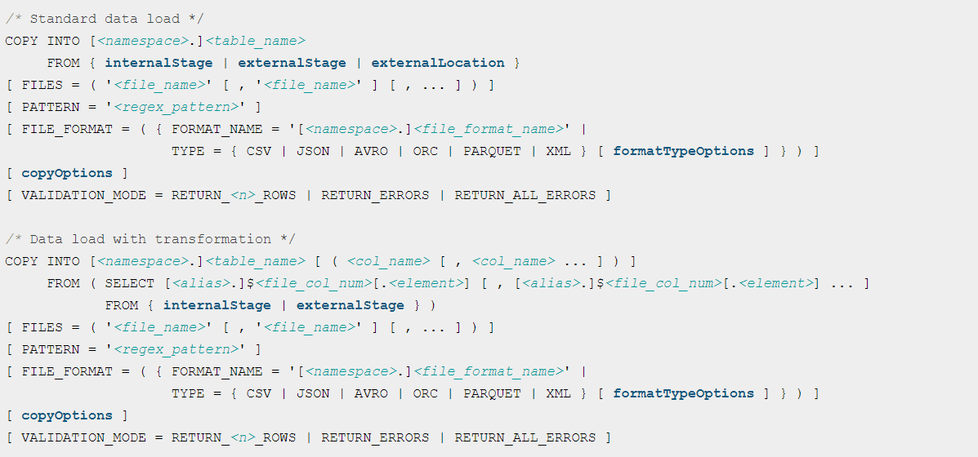
Bulk Copy

Slide 20
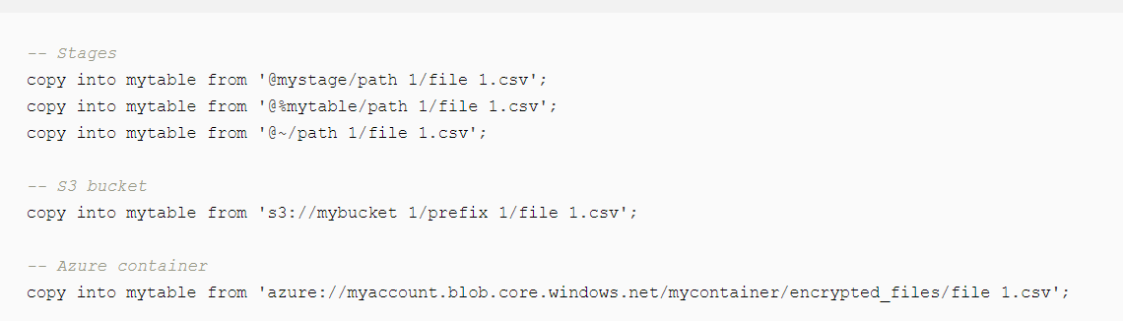
Bulk Copy..

Slide 21
Bulk Copy
Copy Command Examples With Out Validation
Copy into <table Name> From <Stage> file_format=>file_format ON_ERROR = 'skip_file’
Copy into <table Name> From <Stage> file_format=>file_format ON_ERROR = 'abort_statement’
create or replace table save_copy_errors as select * from table(validate(mycsvtable, job_id=>'<query_id>'));
Loading With SQL Statement
COPY INTO EMP
FROM (SELECT $1,$2,$3,$4, TO_DATE($5,'YYYYMMDD'), $6,$7 FROM @MY_S3_STAGE/ (file_format => 'MY_CSV_FORMAT') )
ON_ERROR = CONTINUE;

Slide 22
Data Loading – Bulk Copy Steps
Bulk Copy – Examples
Copy Into Table With Pattern
copy into mytable
file_format = (type = 'CSV')
pattern='.*/.*/.*[.]csv[.]gz';
copy into mytable
file_format = (format_name = myformat)
pattern='.*sales.*[.]csv’;
Copy Into Table With Specific Files
copy into load1 from @%load1/data1/
files=('test1.csv', 'test2.csv')
copy into load1 from @%load1/data1/
files=('test1.csv', 'test2.csv')
force=true;
Copy Into With Purge Option
alter table mytable set stage_copy_options = (purge = true);
copy into mytable;
copy into mytable purge = true;
Copy Into Table With Validation Mode
copy into mytable validation_mode = 'RETURN_ERRORS';
copy into mytable validation_mode = 'RETURN_2_ROWS';
Copy Into Log the Error
set qid=last_query_id();
copy into @mystage/errors/load_errors.txt from (select rejected_record from table(result_scan($qid)));

Slide 23
Data Loading – Bulk Copy Steps
Bulk Copy Steps
Log into Snowflake using snowsql
snowsql -a <account Name> - u <user name>
Set Database, Virtual Ware house
Use database <database name>
Set Schema
use schema <Schema Name>
View Tables in the Schema Show Tables
Show stages
List User Stage
list @~;
List Named Stage
list @my_stage;
No Stages : Create a Stage / Temporary Stage

Slide 24
Data Loading – Bulk Copy Steps
8. Create Stages
create or replace stage my_int_stage copy_options = (on_error='skip_file');
create or replace temporary stage my_temp_int_stage;
create or replace temporary stage my_int_stage file_format = my_csv_format;
9. List Table Stage
list @%<table name>
10. View File Formats
show file formats;
11. Put your file into Stage
put file://<file Path> <target Stage>
12. View if the File is Staged
List <Stage Name>
13. Bulk Copy Into Table
copy into table from @<stage > file_format = csv_format;

Slide 25
Data Loading – Bulk Copy Steps
Step 1.
Create File Format Objects
Step 2.
Create Stage Objects
Step 3.
Stage the Data Files
Step 4.
List the Staged Files (Optional)
Step 5.
Copy Data into the Target Tables
Step 6.
Resolve Data Load Errors Related to Data Issues
Step 7.
Verify the Loaded Data
Step 8.
Remove the Successfully Loaded Data Files
Step 9.
Congratulations!

Slide 26
Data Loading – Trouble Shooting Errors
Validation Mode
Validation_Mode = Return_n_Errors | Return_errors | Return_All_Errors
Return_n_Errors : Validates the specified number of rows, if no errors are encountered; otherwise, fails at the first error encountered in the rows
RETURN_ERRORS : Returns all errors (parsing, conversion, etc.) across all files specified in the COPY statement
RETURN_ALL_ERRORS: Returns all errors across all files specified in the COPY statement, including files with errors that were partially loaded during an earlier load because the ON_ERROR copy option was set to CONTINUE during the load.
VALIDATION_MODE does not support COPY statements that transform data during a load. If the parameter is specified, the COPY statement returns an error
VALIDATE Function : Use Validate Function to get all the errors that you have encountered in your previous load
Example :
set qid=last_query_id();
select * from table(validate(<table_name>, job_id => '<last_query_id>’)); -- No quotes for Table and quotes for _last value)
create or replace table save_copy_errors as select * from table(validate(mycsvtable, job_id=>'<query_id>'));

Slide 27
Data Loading – Trouble Shooting Errors
Copy History Function
This function returns data loading activity within the last 14 days.
select * from table(information_schema.copy_history(table_name=>'MYTABLE', start_time=> dateadd(hours, -1, current_timestamp())));
Result Scan Function
copy into mytable from @mystage/myfile.csv.gz validation_mode=return_all_errors;
set qid=last_query_id();
copy into @mystage/errors/load_errors.txt from (select * from table(result_scan($qid)));
LOAD_HISTORY information schema view
SELECT * FROM information_schema.load_history WHERE schema_name=current_schema() AND table_name='MYTABLE' AND last_load_time > dateadd(hours, -1, current_timestamp()) AND STATUS='LOAD_FAILED';

Slide 28
Data Load - File Specs
CSV / TSV File Considerations
Uncompressed Files, Compressed Files (gzip,bzip2 etc)
Unencrypted 128 or 256 , Encrypted -- Security Key needs to be given which was used for encryption
Data File size 10mb to 100 mb compressed
Split -if its a big file
Numeric Data - No Commas
Semi Structured
Variant - 16 mb
Json, XML file Size 16 mb
Limitation
Values having null are not pulled into a column
STRIP_NULL_VALUES to TRUE
Multiple Data Types
Parquet File
Optimal File Size 1 gb compressed
Transformation
Date Time -- Transform @ Source, Transform while loading
Metadata
Load Metadata - File Load metadata expires after 64 days. If the LAST_MODIFIED date for a staged data file is less than or equal to 64 days, the COPY command can determine its load status for a given table and prevent reloading (and data duplication). With Force Option We can load the file once again bypassing the metadata. LOAD_UNCERTAIN_FILES can be set true for loading the expired files.

Slide 29
Data Load - File Specs
Sort on ingestion: Data is automatically partitioned in SF on natural ingestion order. Sorting an S3 bucket (using something like syncsort) before bulk load via copy could be way faster than inserting with an ORDER BY
CSV (Gzipped) is the best format for loading to SF (2–3x faster than Parquet or ORC)
Use COPY INTO instead of INSERT because it utilizes the more efficient bulk loading processes.

Slide 30
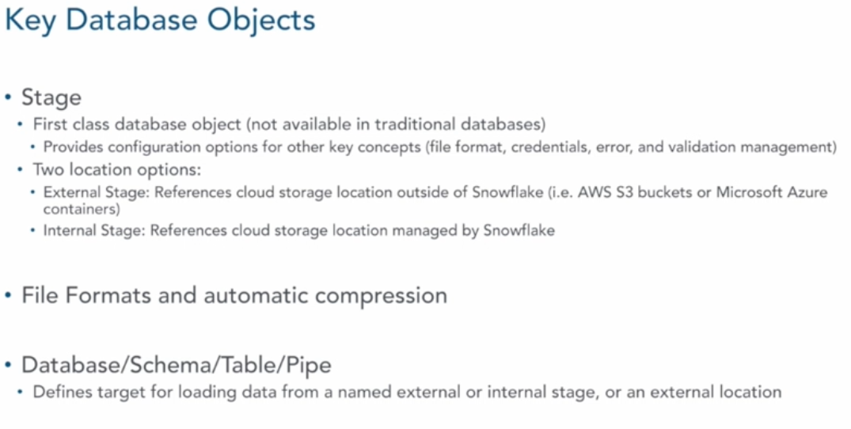
Data Loading – DB Objects

Slide 31
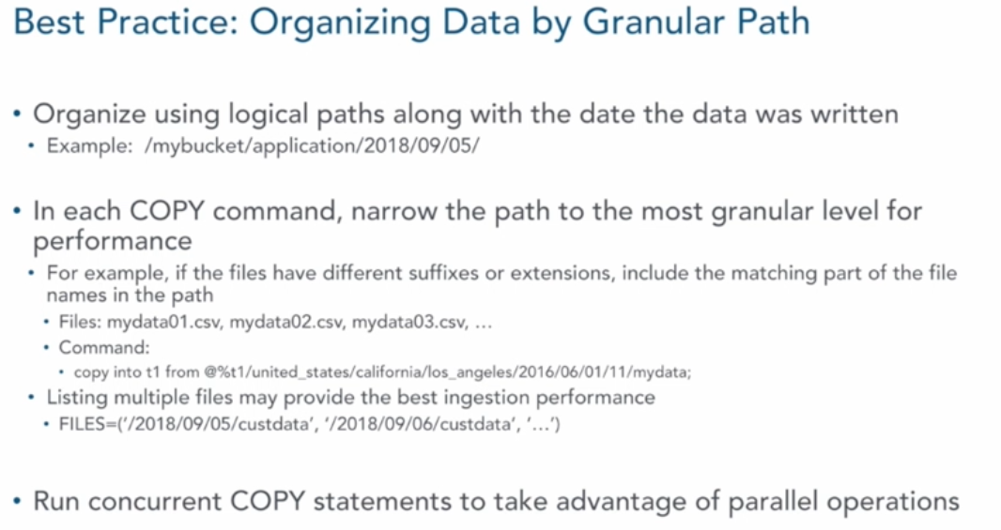
Data Loading – Best Practices

Slide 32
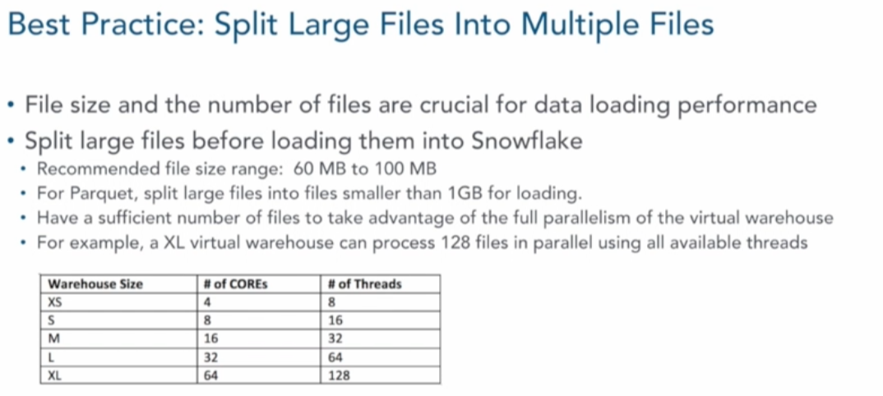
Data Loading – Best Practices

Slide 33
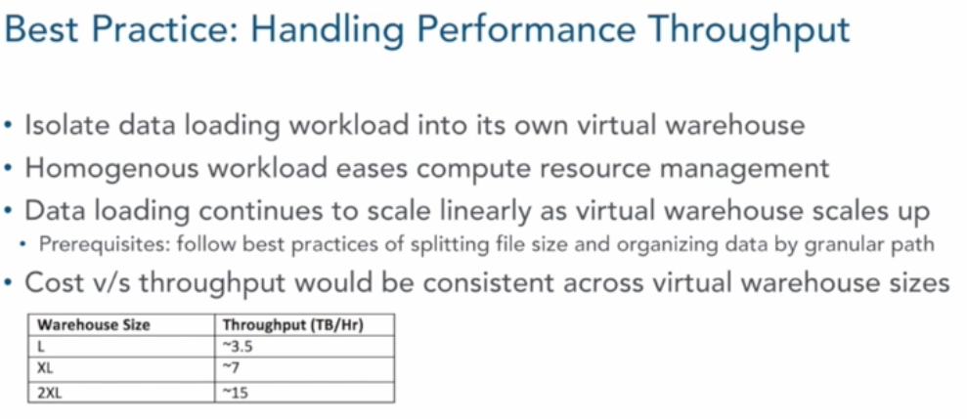
Data Loading – Best Practices

Slide 34
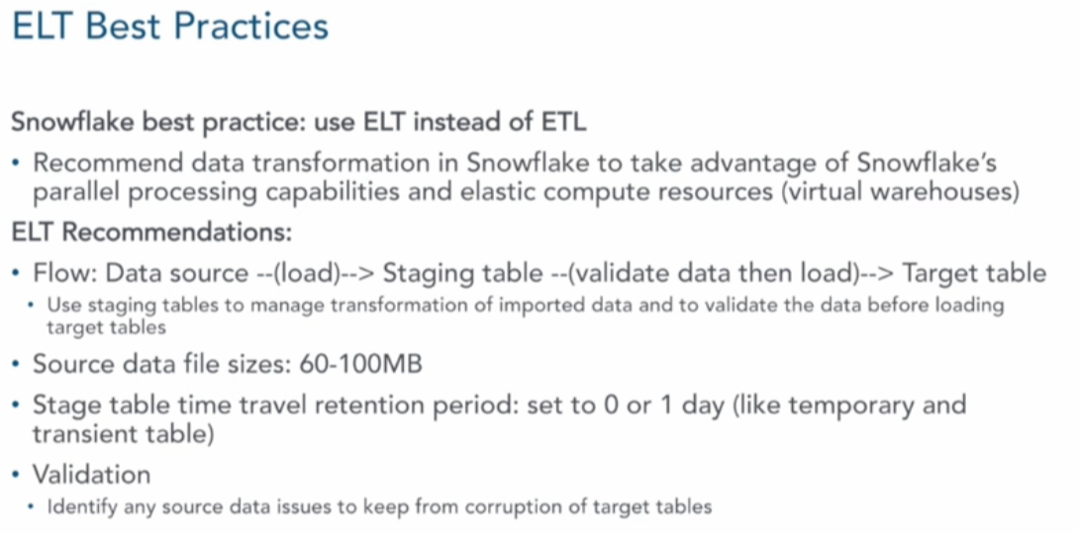
Data Loading – Best Practices

Slide 35
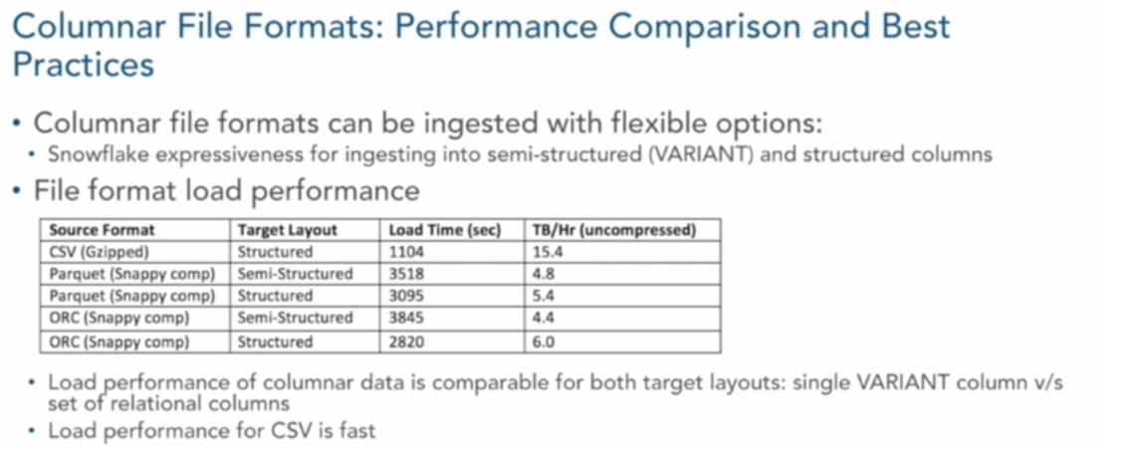
Data Loading – Best Practices

Slide 36
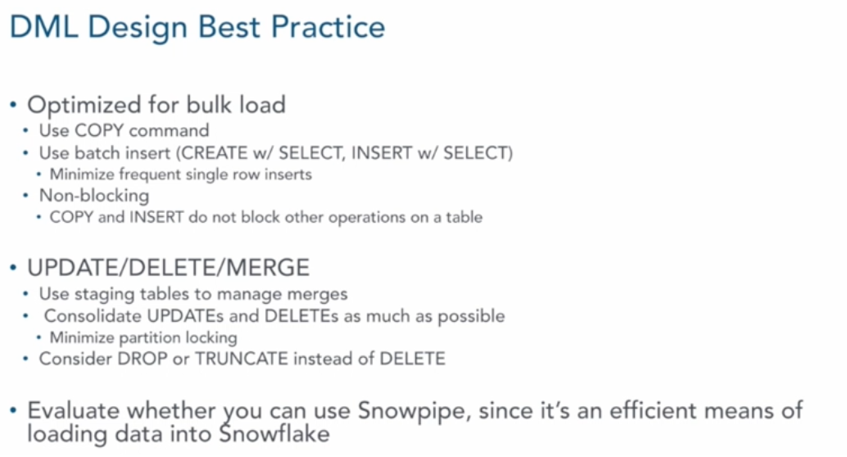
Data Loading – Best Practices

Slide 37
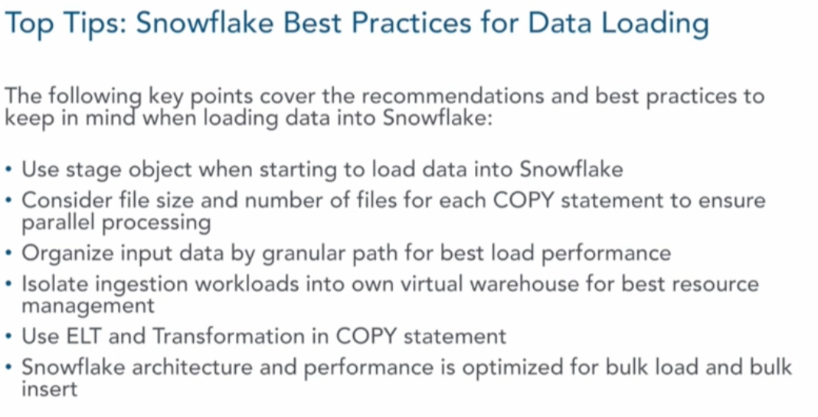
Data Loading – Best Practices

